Slide 1



Real estate pricing project
EXPLORATORY DATA ANALYSIS-
FEB ,2025
KALAVATHI ALEGAPALLI

Slide 2

LINKS for Dictionary and housingdata.CSV
Download the dataset “Housing Data.csv” and upload the dataset in your project environment.
The data dictionary can be accessed here.

Slide 3
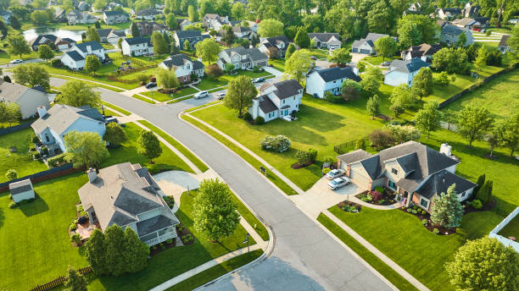
Introduction
EDA is indispensable in extracting actionable insights from raw data, especially in domains like real estate where numerous factors contribute to the final property value.
we can identify key variables that significantly impact house prices, allowing us to tailor pricing strategies, enhance customer satisfaction, and gain a competitive edge in the market.
EDA helps us uncover hidden relationships, outliers, and trends that may be obscured at first glance, ensuring a comprehensive analysis that goes beyond surface-level observations.

Slide 4
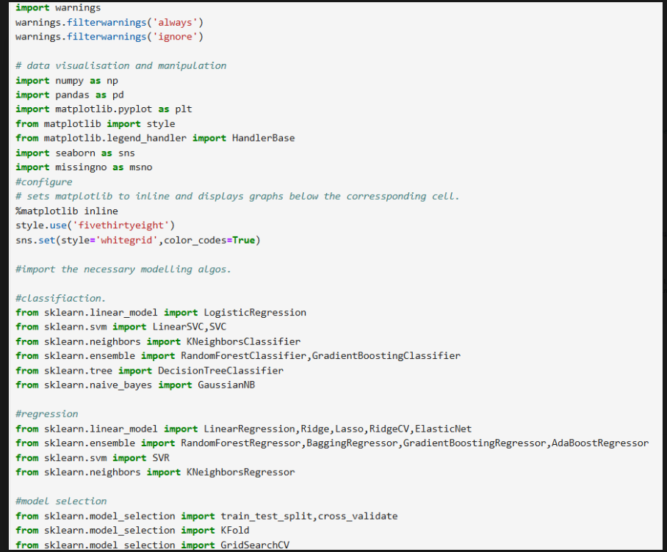
Importing Required libraries:
Well-structured Imports – Covers data handling (numpy, pandas), visualization (matplotlib, seaborn), and ML (sklearn).
Visualization Setup – Uses fivethirtyeight and whitegrid styles for clear plots.
Diverse ML Models – Includes classification, regression, and model selection techniques, covering tree-based, linear, and ensemble methods.
Possible Improvements – Remove/comment %matplotlib inline if not needed, add preprocessing imports (StandardScaler, LabelEncoder), and organize imports for readability.

Slide 5
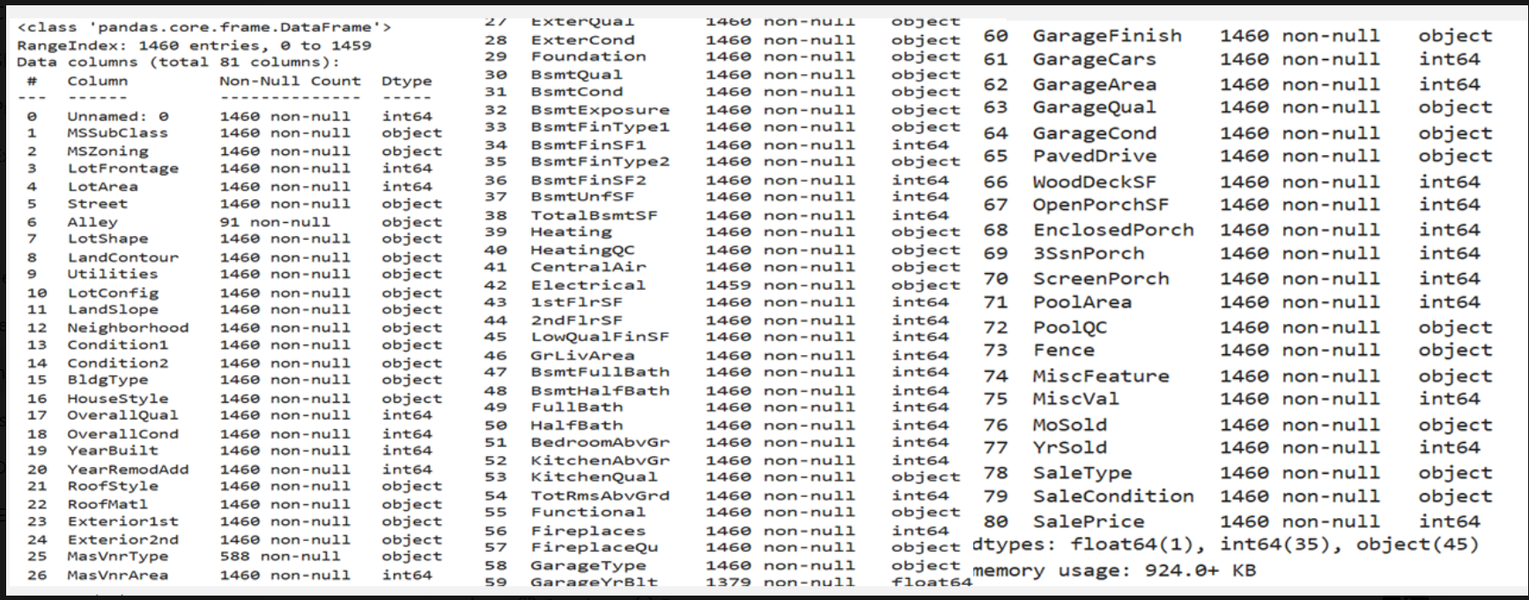
Dataset Overview: Features and Data Types The dataset contains 81 columns with 1460 entries each, consisting of numerical (int64, float64) and categorical (object) data types.Some features, like GarageYrBlt and Electrical, have missing values.A mix of housing-related attributes such as LotFrontage, YearBuilt, GarageArea, and SalePrice suggests it’s a real estate dataset.Proper handling of missing values and categorical encoding is necessary for effective modeling.

Slide 6
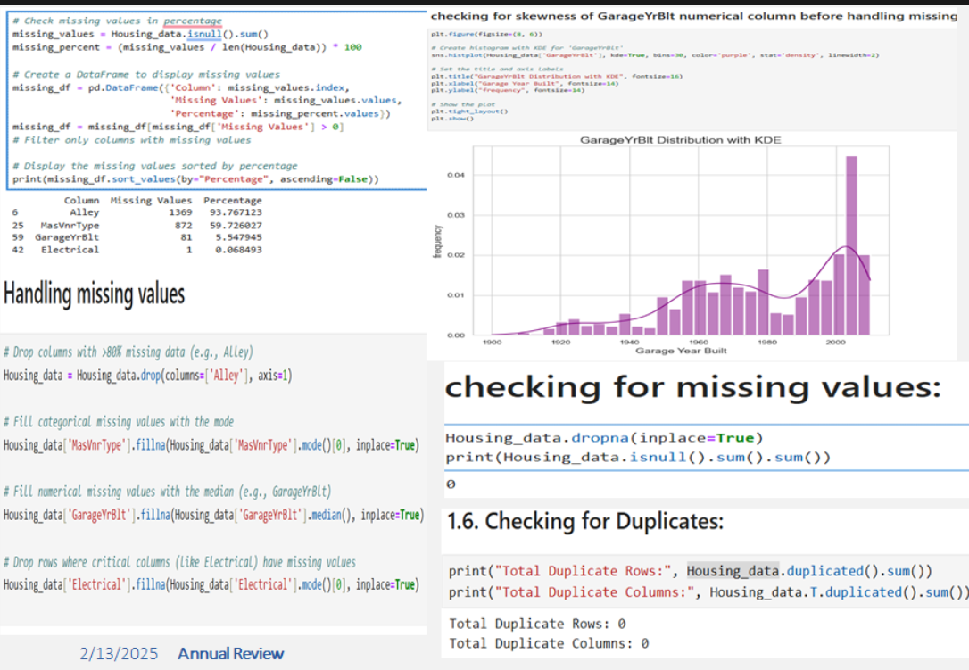
Data Cleaning: Handling Missing Values and Duplicates 1. The dataset had missing values in features like Alley (93.76%), MasVnrType (59.76%), GarageYrBlt (5.57%), and Electrical (0.07%). 2. Missing values were addressed by dropping columns with excessive missing data and imputing categorical values with the mode and numerical values with the median. 3.Skewness in GarageYrBlt was analyzed before imputing to ensure better distribution. 4. Duplicate checks confirmed 0 duplicate rows and columns, ensuring data consistency. 5.Final validation confirmed no missing values remain, preparing the dataset for modeling.

Slide 7
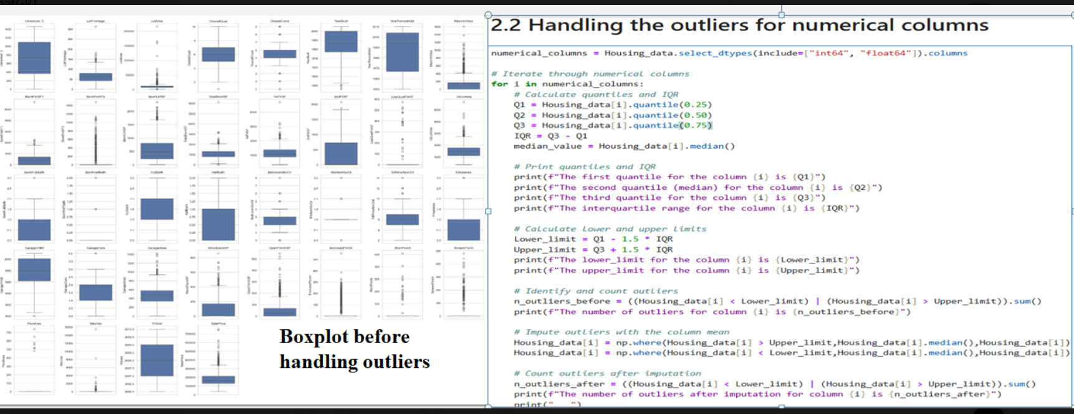
Handling Outliers in Numerical Columns 1. Boxplots show significant outliers in multiple numerical columns before handling them. 2. The IQR (Interquartile Range) method is used to calculate lower and upper bounds for detecting outliers. 3. Outliers are identified and imputed with the column median to maintain data consistency. 4. A comparison of outliers before and after imputation ensures proper handling without data loss. 5.This step improves model performance by reducing the impact of extreme values.

Slide 8
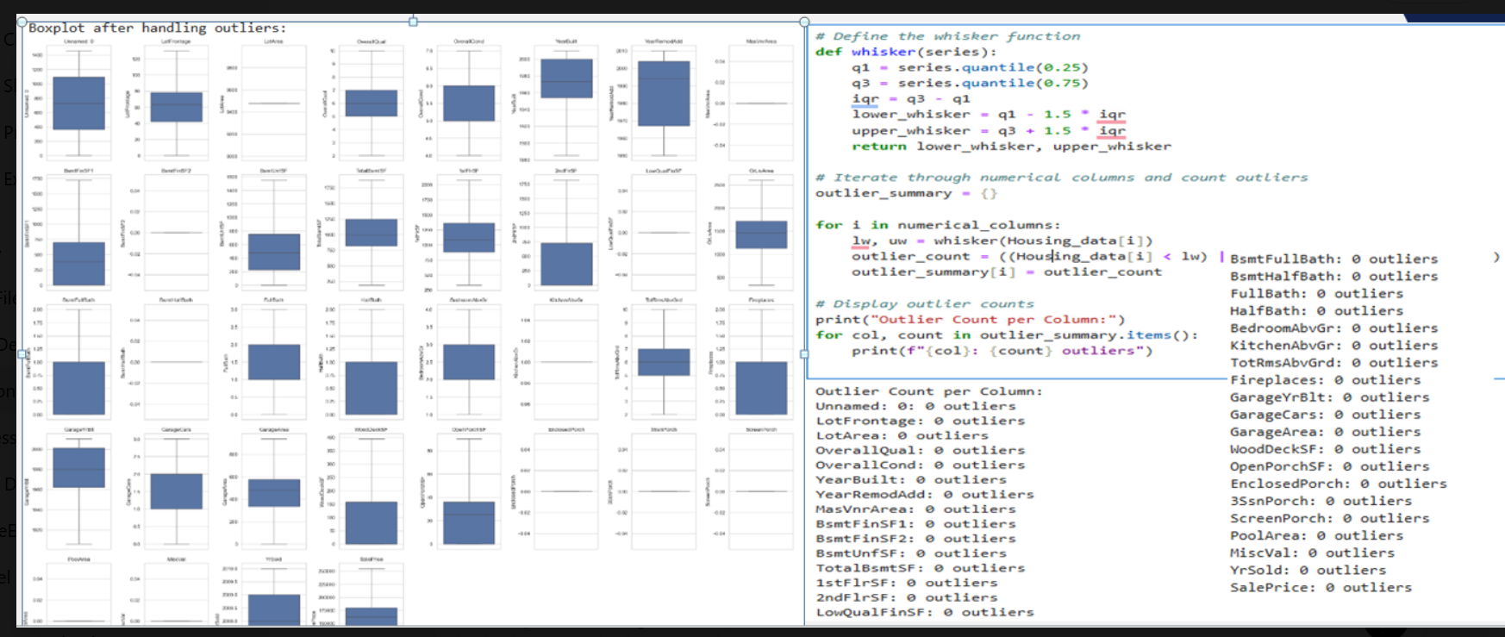
Boxplot Analysis After Handling Outliers 1. The updated boxplots show that outliers have been successfully handled, with extreme values removed or adjusted. 2. The IQR-based whisker function was used to identify and cap outliers, ensuring a more normally distributed dataset. 3.The summary confirms that all numerical columns now contain zero outliers, improving data quality. 4. This step enhances model performance by reducing the influence of extreme values and improving generalization.

Slide 9
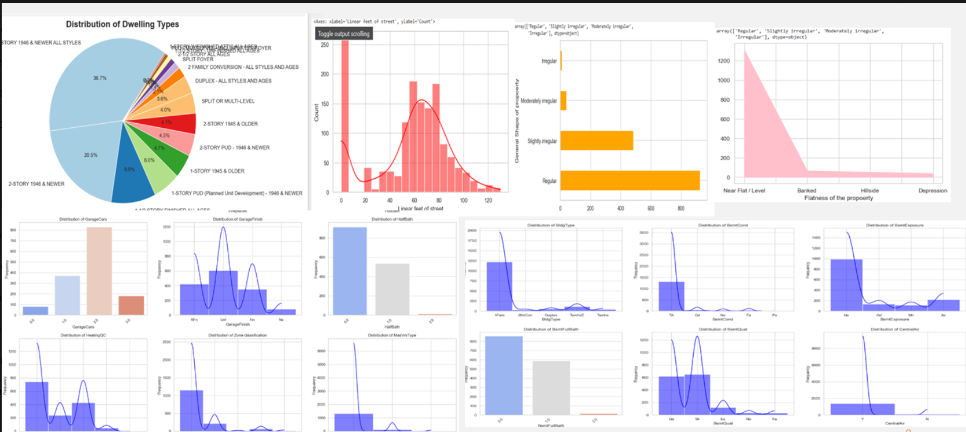
Univariant analysis 1. The dataset primarily consists of 2-story and 1-story homes, with most properties having near-flat terrain and a regular shape. 2.Most homes feature garages for two cars, central air conditioning, and typical-quality basements. 3.Street frontage varies mostly between 20 to 80 feet, and heating quality is generally standard. 4. The distribution of building types, masonry, and basement exposure suggests a mix of property characteristics, with some variations in structure and finishes. And more insights and visuals in ipynb file

Slide 10
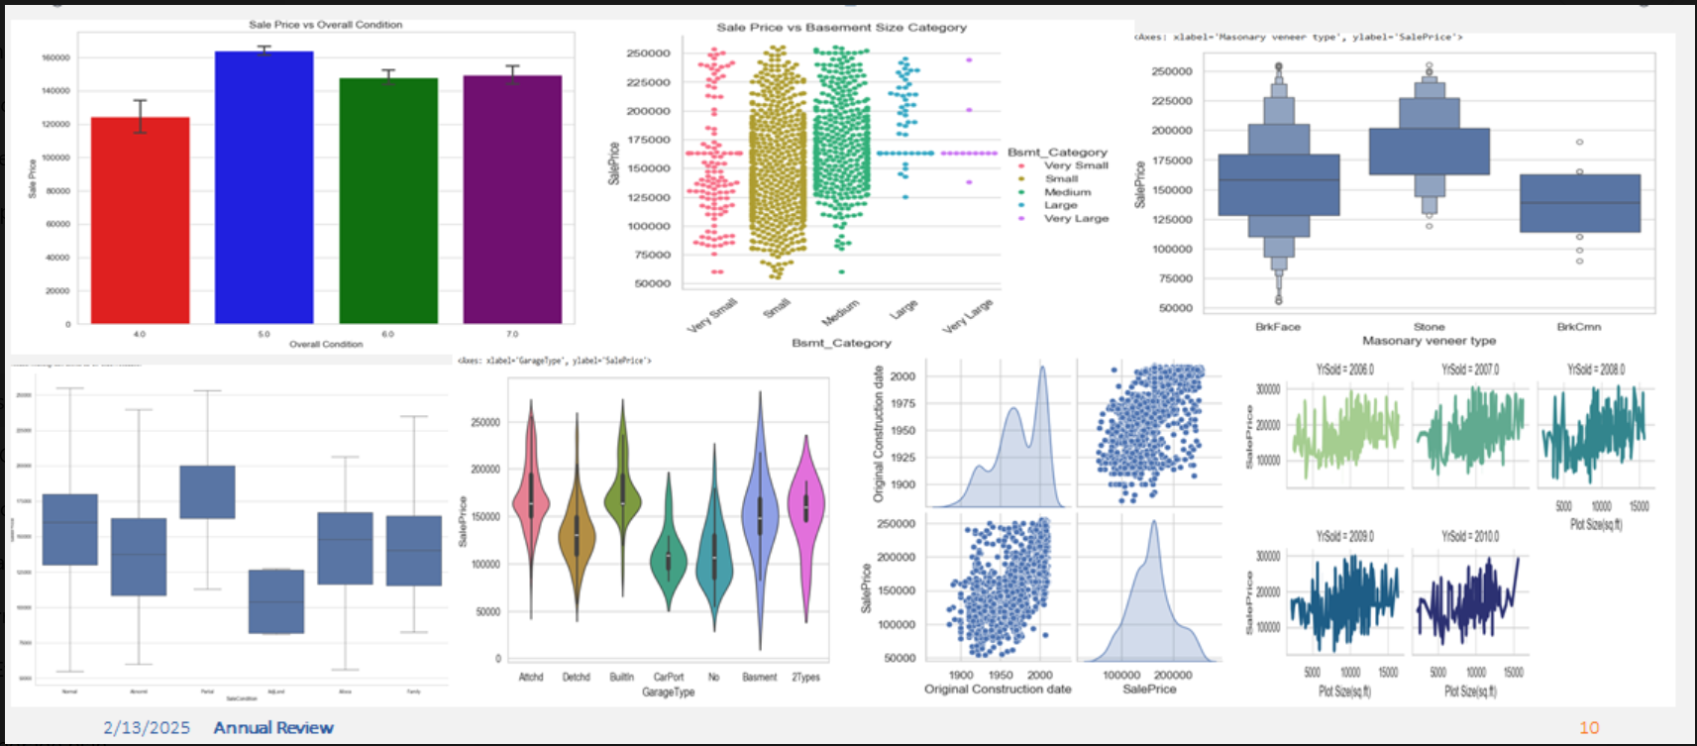
Bivariate analysis: 1.Sale price tends to increase with better overall condition and larger basement size. Homes with stone masonry veneer generally have higher prices than those with brick. 2. Garage type and basement category also influence pricing, with attached garages and larger basements correlating with higher sale prices. 3. Newer homes tend to have higher values, and plot size shows varying trends in relation to sale price across different construction years. And more insights and visuals in ipynb file

Slide 11
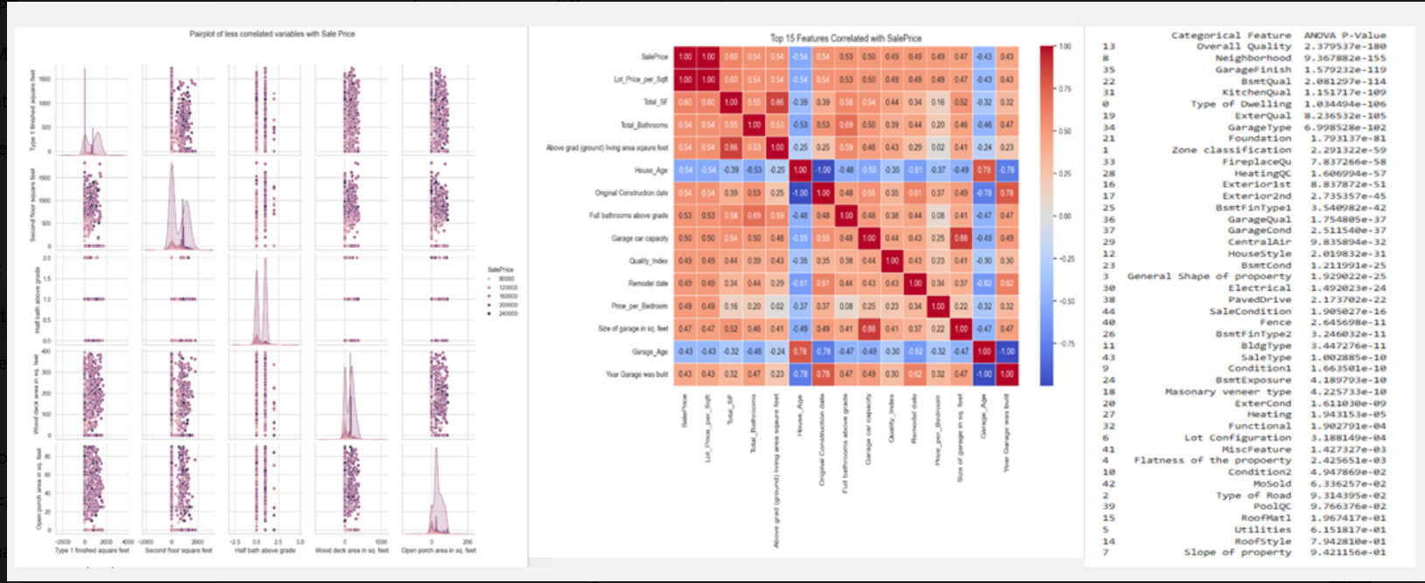
Heading: Key Factors Affecting Property Sale Price 1. The pairplot shows weak correlations between certain variables (e.g., second-floor square footage, half-bathrooms, and open porch area) and sale price, indicating they have minimal impact. 2.The correlation heatmap highlights that lot size, total bathrooms, living area, house age, and garage-related features are among the strongest predictors of sale price. 3.The ANOVA results identify overall quality, neighborhood, basement finish, and type of dwelling as highly significant categorical features influencing sale price. 4. Features like roof style and slope of the property show very weak correlations, suggesting they have little effect on pricing decisions. 5. The combination of numerical and categorical feature analysis helps pinpoint key drivers of home value, which can be useful for real estate pricing models.

Slide 12
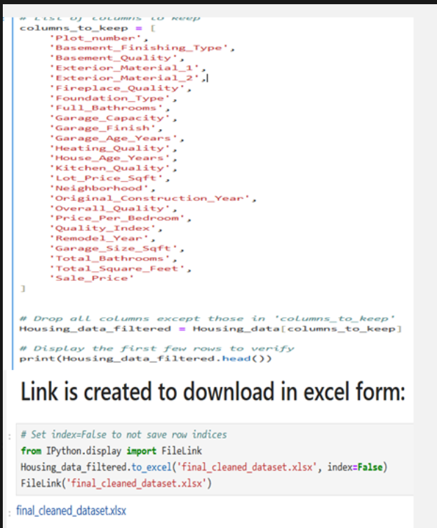
Data Cleaning and Feature Selection Process
1. The dataset underwent column renaming based on a predefined dictionary for consistency and clarity.
2.Feature selection was performed by keeping the top 15 most correlated numerical features with sale price and 10 significant categorical features identified through ANOVA p-values.
3. Unnecessary columns were dropped to reduce noise and improve model performance.
4.The cleaned dataset was saved as an Excel file (final_cleaned_dataset.xlsx), with a download link provided.
5. A detailed explanation of the process, including transformations and justifications, is available in the accompanying Jupyter Notebook (.ipynb file).

Slide 13
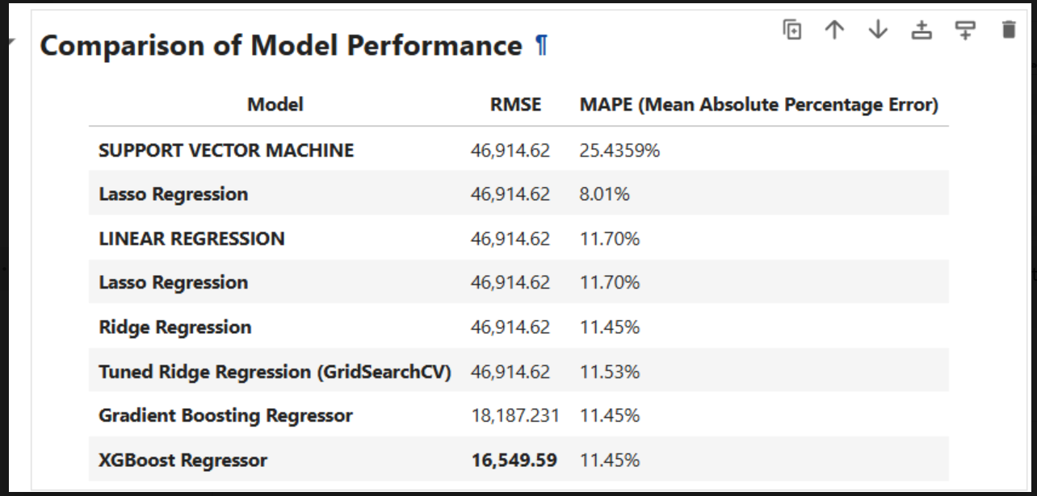
Model Performance Comparison
1. XGBoost Regressor performed the best with the lowest RMSE (16,549.59) and a reasonable MAPE (11.45%), making it the most accurate model.
2. Gradient Boosting Regressor also showed strong performance with an RMSE of 18,187.23, slightly higher than XGBoost but still significantly better than linear models.
3. Traditional regression models (Linear, Lasso, Ridge, and Tuned Ridge) had a much higher RMSE (46,914.62), indicating poor predictive performance compared to ensemble models.
4. Support Vector Machine (SVM) performed the worst with a MAPE of 25.43%, suggesting it struggles to fit the data effectively.
5. Overall, boosting models (XGBoost and Gradient Boosting) outperformed linear and SVM models, making them preferable for this dataset.

Slide 14
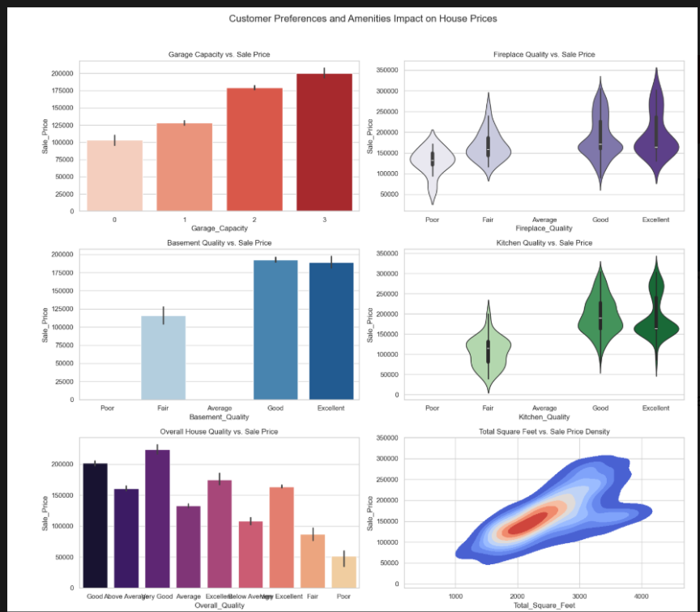
Impact of Customer Preferences and Amenities on House Prices
1.Garage Capacity: Houses with larger garage capacities (3 cars) have the highest sale prices, indicating buyers prefer more parking space.
2.Basement Quality: Higher basement quality (Good/Excellent) significantly increases house prices, while poor basements lead to lower valuations.
3.Fireplace & Kitchen Quality: While not as strong a determinant as basement or garage, houses with better fireplace and kitchen quality tend to have higher sale prices, as seen in the violin plots.
4. Overall House Quality: The most influential factor—houses with higher overall quality ratings fetch significantly higher prices.
5.Total Square Feet: There is a strong positive correlation between total square footage and sale price, confirming that larger houses tend to sell at a premium.

Slide 15
References:
https://www.geeksforgeeks.org/data-analysis-visualization-python/?ref=gcse_ind
http://pandas.pydata.org/pandas-docs/stable/tutorials.html
https://www.datacamp.com
https://www.geeksforgeeks.org/data-wrangling-in-python/?ref=gcse_ind
https://www.youtube.com/watch?v=cN3i8ktEg54&list=PLq7bAUXvGrZX8OEg3UBXKT3Fr10Ilvp9P&index=5
https://seaborn.pydata.org/index.html
https://www.youtube.com/watch?v=SM95HJ1CCdM&list=PLP_4EPVEox9-Vc0pXKnnso3SOIpP_6SLQ
https://builtin.com/articles/feature-engineering
https://www.geeksforgeeks.org/what-is-feature-engineering/

Slide 16

THANK YOU

